Slide 1
Chapter 3: Linked Lists

Slide 2
Introduction
Arrays are useful in many applications but suffer from two significant limitations
The size of the array must be known at the time the code is compiled
The elements of the array are the same distance apart in memory, requiring potentially extensive shifting when inserting a new element
This can be overcome by using linked lists, collections of independent memory locations (nodes) that store data and links to other nodes
Moving between the nodes is accomplished by following the links, which are the addresses of the nodes
There are numerous ways to implement linked lists, but the most common utilizes pointers, providing great flexibility

Slide 3
Singly Linked Lists
If a node contains a pointer to another node, we can string together any number of nodes, and need only a single variable to access the sequence
In its simplest form, each node is composed of a datum and a link (the address) to the next node in the sequence
This is called a singly linked list, illustrated in figure 3.1
Notice the single variable p used to access the entire list
Also note the last node in the list has a null pointer ( \ )

Slide 4
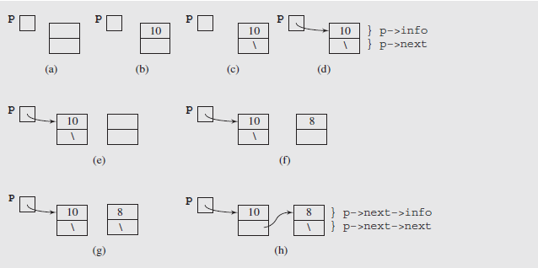
Singly Linked Lists (continued)
Fig. 3.1 A singly linked list
The nodes in this list are objects created from the following class definition

Slide 5
Singly Linked Lists (continued)
class IntSLLNode {
public:
IntSLLNode() {
next = 0;
}
IntSLLNode(int i, IntSLLNode *in = 0){
info = i; next = in;
}
int info;
IntSLLNode *next;
}
As can be seen here and in the previous figure, a node consists of two data members, info and next

Slide 6
Singly Linked Lists (continued)
The info member stores the node’s information content; the next member points to the next node in the list
Notice that the definition refers to the class itself, because the next pointer points to a node of the same type being defined
Objects that contain this type of reference are called self-referential objects
The definition also contains two constructors
One sets the next pointer to 0 and leaves info member undefined
The other initializes both members
The remainder of figure 3.1 shows how a simple linked list can be created using this definition

Slide 7
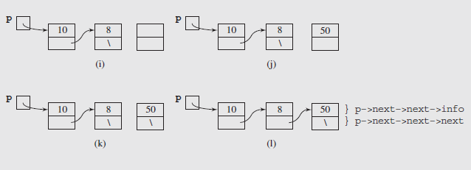
Singly Linked Lists (continued)
Fig. 3.1 (continued) A singly linked list
This example illustrates a disadvantage of single-linked lists: the longer the list, the longer the chain of next pointers that need to be followed to a given node
This reduces flexibility, and is prone to errors
An alternative is to use an additional pointer to the end of the list, as seen in figure 3-2 (pages 78-80) and figure 3-3(a)

Slide 8
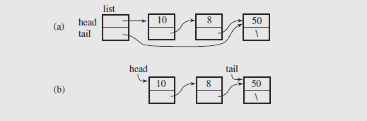
Singly Linked Lists (continued)
The code uses two classes
IntSLLNode, which defines the nodes of the list
IntSLList, which defines two pointers, head and tail, as well as various member functions to manipulate the list
An example of this list in shown in figure 3-3
Fig. 3-3 A singly linked list of integers

Slide 9
Singly Linked Lists (continued)
While figure 3-3a shows the structure of the list, a more common representation is shown in figure 3-3b
Let’s consider some common operations on this type of list
Insertion
Inserting a node at the beginning of a list is straightforward
First, a new node is created (figure 3-4a)
The info member of the node is initialized (figure 3-4b)
The next member is initialized to point to the first node in the list, which is the current value of head (figure 3-4c)
head is then updated to point to the new node (figure 3-4d)

Slide 10
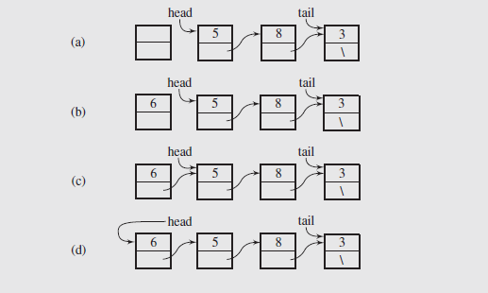
Singly Linked Lists (continued)
Fig. 3-4 Inserting a new node at the beginning of a singly linked list
Note that if the list is initially empty, both head and tail would be set to point to the new node

Slide 11
Singly Linked Lists (continued)
Insertion (continued)
Inserting a node at the end of a list is likewise easy to accomplish as illustrated in the next slide
The new node is created and the info member of the node is initialized (figures 3-5a and 3-5b)
The next member is initialized to null, since the node is at the end of the list (figure 3-5c)
The next member of the current last node is set to point to the new node (figure 3-5d)
Since the new node is now the end of the list, the tail pointer has to be updated to point to it (figure 3-5e)
As before, if the list is initially empty, both head and tail would be set to point to the new node

Slide 12
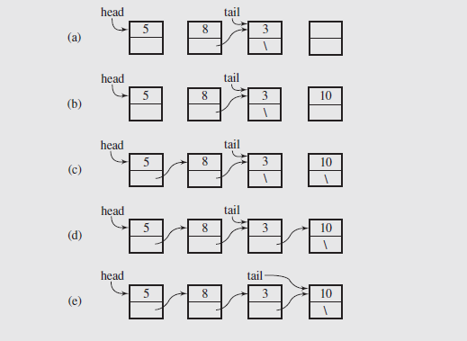
Singly Linked Lists (continued)
Fig. 3-5 Inserting a new node at the end of a singly linked list

Slide 13
Singly Linked Lists (continued)
Deletion
The operation of deleting a node consists of returning the value stored in the node and releasing the memory occupied by the node
Again, we can consider operations at the beginning and end of the list
To delete at the beginning of the list, we first retrieve the value stored in the first node (head → info)
Then we can use a temporary pointer to point to the node, and set head to point to head → next
Finally, the former first node can be deleted, releasing its memory
These operations are illustrated in figure 3.6(a) – (c)

Slide 14
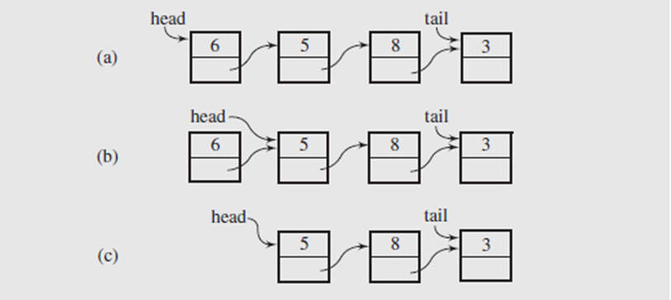
Singly Linked Lists (continued)
Deletion (continued)
Fig. 3-6 Deleting a node at the beginning of a singly linked list
Two special cases exist when carrying out this deletion
The first arises when the list is empty, in which case the caller must be notified of the action to take
The second occurs when a single node is in the list, requiring that head and tail be set to null to indicate the list is now empty

Slide 15
Singly Linked Lists (continued)
Deletion (continued)
Deleting at the end of a list requires additional processing
This is because the tail pointer must be backed up to the previous node in the list
Since this can’t be done directly, we need a temporary pointer to traverse the list until tmp → next = tail
This is illustrated in figures 3-7 (a) – (c) in the next slide
Once we have located that node, we can retrieve the value contained in tail → info, delete that node, and set tail = tmp
This is illustrated in figures 3-7 (d) – (f) in the next slide

Slide 16
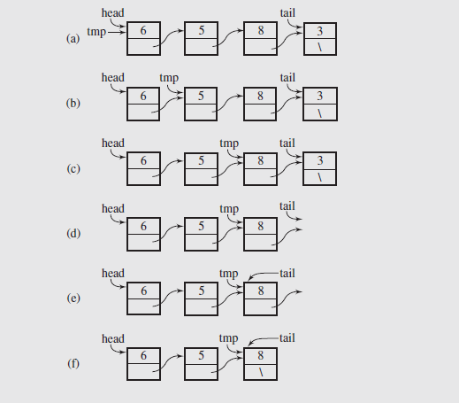
Singly Linked Lists (continued)
Fig. 3-7 Deleting a node from the end of a singly linked list

Slide 17
Singly Linked Lists (continued)
Deletion (continued)
The same special cases apply to deleting a node from the end of a list as they did to deleting a node from the beginning of a list
Now these deletion operations simply delete the physically first or last node in the list
What if we want to delete a specific node based on its info member?
In that case we have to locate the specific node, then link around it by linking the previous node to the following node
But again, to do this we need to keep track of the previous node, and we need to keep track of the node containing the target value
This will require two pointers, as shown in figure 3-8 (a) – (d)

Slide 18
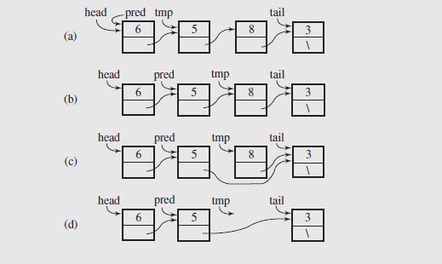
Singly Linked Lists (continued)
Fig. 3-8 Deleting a node from a singly linked list
As can be seen, the two extra pointers, pred and tmp, are initialized to the first and second nodes in the list
They traverse the list until tmp → info matches the target value

Slide 19
Singly Linked Lists (continued)
Deletion (continued)
At that point, we can set pred → next = tmp → next which “bypasses” the target node, allowing it to be deleted
There are several cases to consider when this type of deletion is carried out
Removing a node from an empty list or trying to delete a value that isn’t in the list
Deleting the only node in the list
Removing the first or last node from a list with at least two nodes

Slide 20
Singly Linked Lists (continued)
Searching
The purpose of a search is to scan a linked list to find a particular data member
No modification is made to the list, so this can be done easily using a single temporary pointer
We simply traverse the list until the info member of the node tmp points to matches the target, or tmp → next is null
If the latter case occurs, we have reached the end of the list and the search fails

Slide 21
Doubly Linked Lists
The difficulty in deleting a node from the end of a singly linked list points out one major limitation of that structure
We continually have to scan to the node just before the end in order to delete correctly
If the nature of processing requires frequent deletions of that type, this significantly slows down operations
To address this problem, we can redefine the node structure and add a second pointer that points to the previous node
Lists constructed from these nodes are called doubly linked lists, one of which is shown in figure 3-9

Slide 22
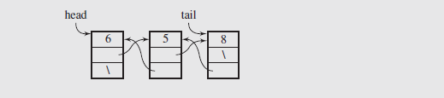
Doubly Linked Lists (continued)
Fig. 3-9 A doubly linked list
The code that implements and manipulates this is shown in part in figure 3-10 (pages 91 and 92)
The methods that manipulate these types of lists are slightly more complicated than their singly linked counterparts
However, the process is still straightforward as long as one keeps track of the pointers and their relationships
We’ll look at two: inserting and removing a node at the end of the list

Slide 23
Doubly Linked Lists (continued)
Insertion of a new node requires the following steps:
First, the new node is created and the data member is initialized
Since the node is being inserted at the end of the list, its next member is set to null
The prev member is set to tail to link it back to the former end of the list
The tail pointer is now set to point to this new node
To complete the link, the next member of the previous node is set to point to the new node
These steps are illustrated in figure 3.11(a) – (f)

Slide 24
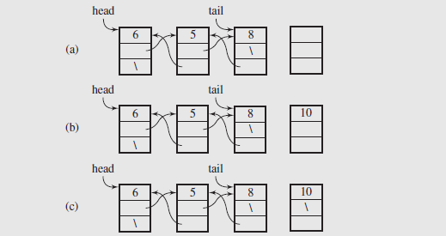
Doubly Linked Lists (continued)
Fig. 3-11 Adding a new node at the end of a doubly linked list

Slide 25
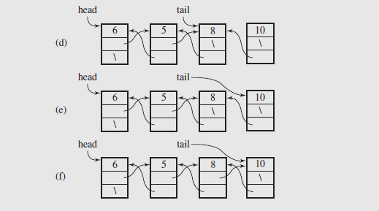
Doubly Linked Lists (continued)
Fig. 3-11 (continued) Adding a new node at the end of a doubly linked list

Slide 26
Doubly Linked Lists (continued)
Insertion (continued)
A special case exists if the node being inserted is the only node in the list
In this case there is no previous node, so both head and tail point to the new node and in the last step, head would be set to point to the new node
Deletion
Deleting a node from the end of a doubly linked list is also easy, because there is a direct link to the previous node in the list
This eliminates the need to traverse the list to find the previous node
To do this, we retrieve the data member from the node, then set tail to the node’s predecessor

Slide 27
Doubly Linked Lists (continued)
Deletion
The node can then be deleted, and the next pointer of the new last node set to null
This process is illustrated in figure 3-12(a) – (d)
A couple of special cases need to be dealt with
If the node being deleted is the only node in the list, head and tail need to be set to null
Also, if the list is empty, an attempt to delete a node should be handled and reported to the user

Slide 28
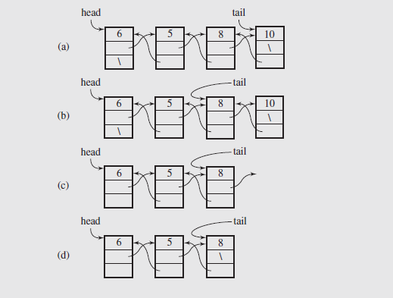
Doubly Linked Lists (continued)
Fig. 3-12 Deleting a node from the end of a doubly linked list

Slide 29
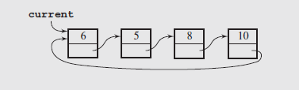
Circular Lists
Another useful arrangement of nodes is the circular list; in this structure the nodes form a ring
Fig. 3-13 A circular singly linked list
The implementation requires only one permanent pointer (usually referred to as tail)
Insertions at the front and the end of this type of list are shown in figure 3-14(a) and (b)

Slide 30
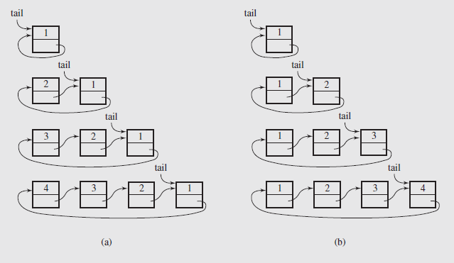
Circular Lists (continued)
Fig. 3-14 Inserting nodes (a) at the front of a circular singly linked list and (b) at its end

Slide 31
Circular Lists (continued)
Code to insert a node at the end of the list follows:
void addToTail(int el) {
if (isEmpty()) {
tail = new IntSLLNode(el);
tail->next = tail;
}
else {
tail->next =
new IntSLLNode(el,tail->next);
tail = tail->next;
}
}

Slide 32
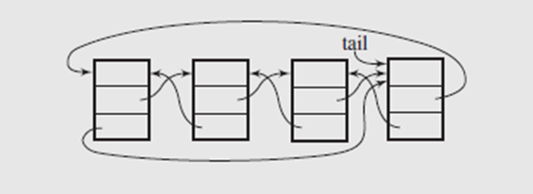
Circular Lists (continued)
The simplicity of this list does present a few problems
Deleting nodes requires a loop to locate the predecessor of the tail node, much as we saw with singly linked lists
Operations that require processing the list in reverse are going to be inefficient
To deal with this, the list can be made doubly linked
This forms two rings, one going forward through the next pointers, and the other backwards through the prev pointers
This is illustrated in figure 3-15
Fig. 3-15 A circular doubly linked list

